Slide 1
Bar Modelling
What is Bar Modelling?
Part, Part, Whole?
How do I know when to use it?
How to apply Bar Modelling to mathematical questions?

Slide 2
When solving word problems, it is often not the calculation that children can’t do – rather they are not sure which calculation they need to do.
(NCETM, 2013)

Slide 3
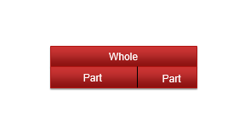
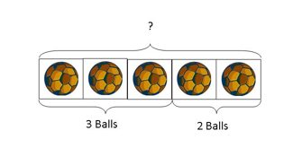
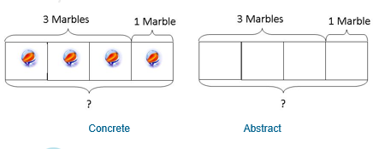
Part, Part, Whole
5
4
1

Slide 4
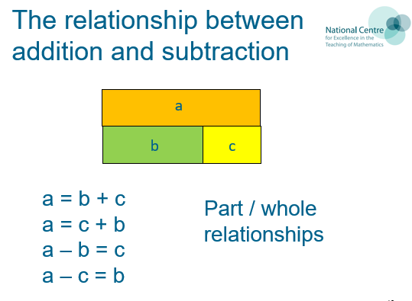

Slide 5
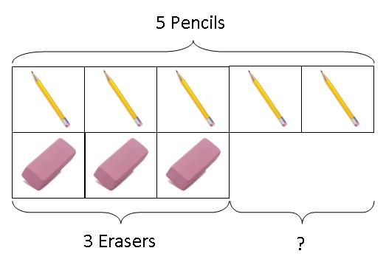
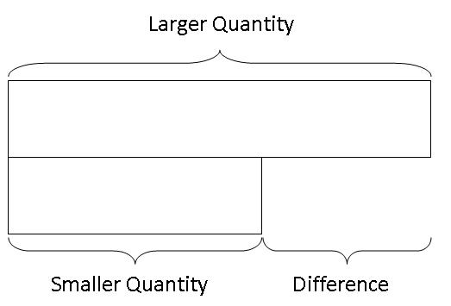
I have 5 pencils and 3 erasers. How may more pencils do I have than erasers?

Slide 6
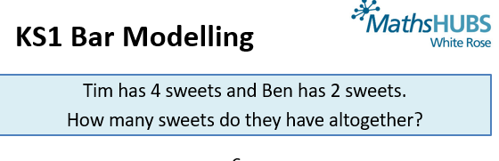
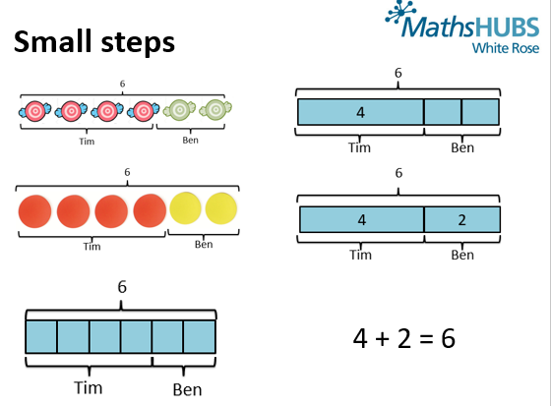

Slide 7
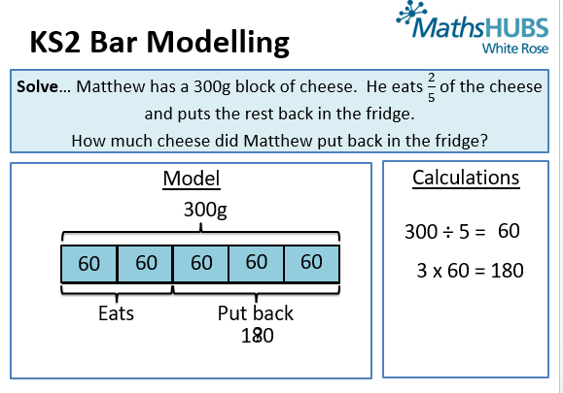

Slide 8
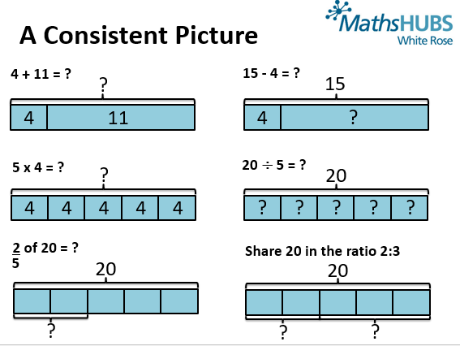

Slide 9
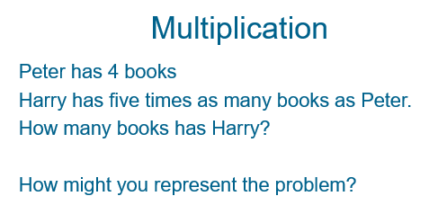

Slide 10
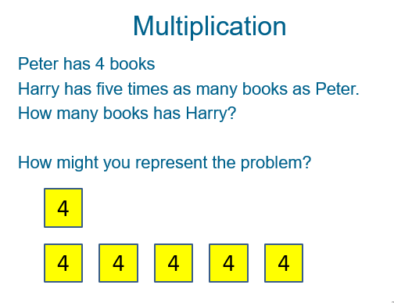

Slide 11
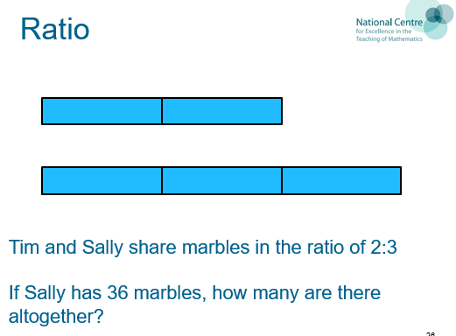

Slide 12
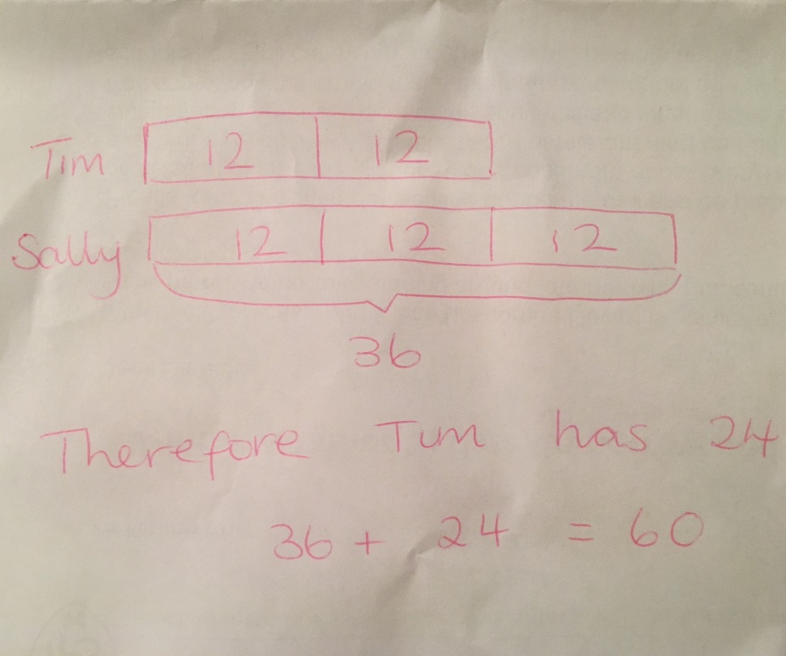
If Sally has 36 then each section is worth 12 marbles.
(3 sections each containing 12 marbles = 36 marbles)
Therefore Tim has two sets of 12 marbles = 24 marbles
In total there are 36 + 24 marbles……. 36 + 24 = ?
There are 60 marbles in total

Slide 13
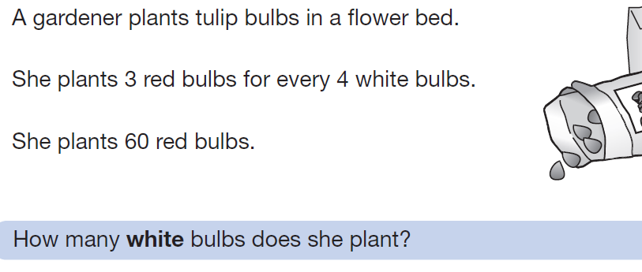
Key Stage 2 SATS

Slide 14
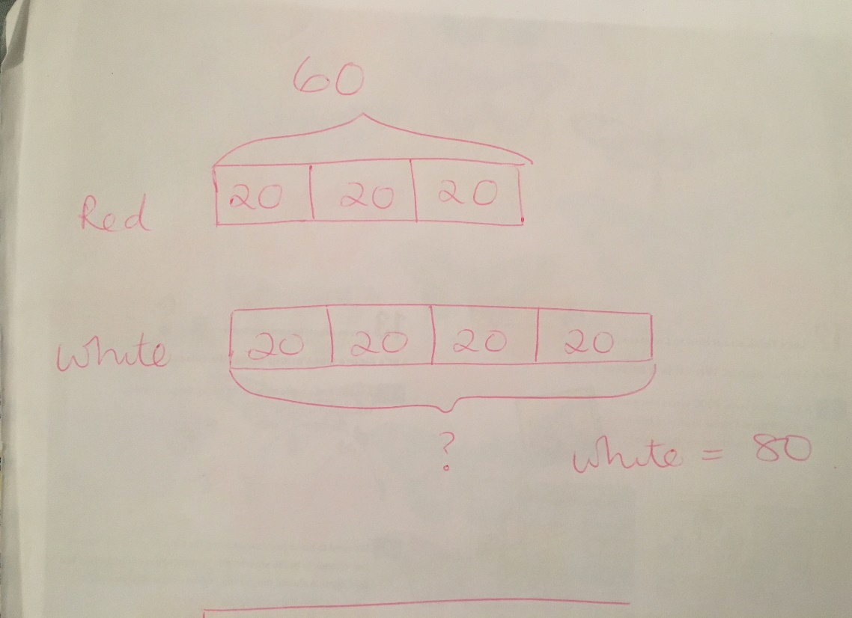
Red : White
3 : 4 Total Bulbs = 7
30 : 40
60 : 80
60 red bulbs ( 3 x 20 )
Therefore the number of white bulbs is 4 x 20 = 80

Slide 15
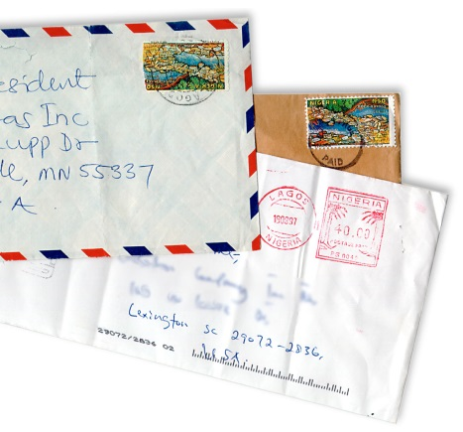
GCSE higher paper 2012!
Ralph posts 40 letters, some of which are first class, and some are second.
He posts four times as many second class letters as first.
How many of each class of letter does he post?

Slide 16
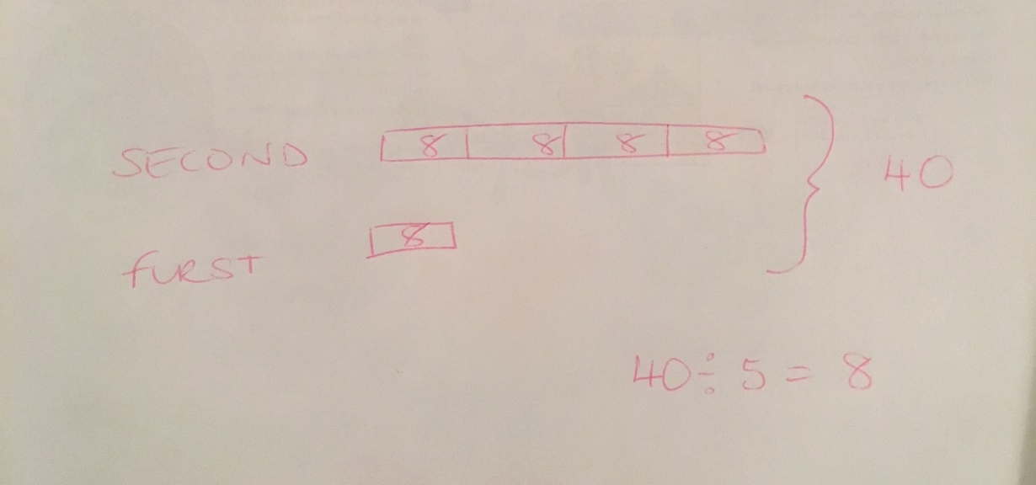
Ralph posts 40 letters, some of which are first class, and some are second.
He posts four times as many second class letters as first.
How many of each class of letter does he post?
Second Class: First Class
4 : 1 ……… Total Letters =5
I want 8 times more letters (5 x 8 = 40)
4 x 8 = 32
1 x 8 = 8
OR
8:2 ………. Total Letters = 10
16:4 ……… Total Letters = 20
32:8 ……… Total Letters = 40
He posts 32 Second Class Letters and 8 First Class Letters

Slide 17
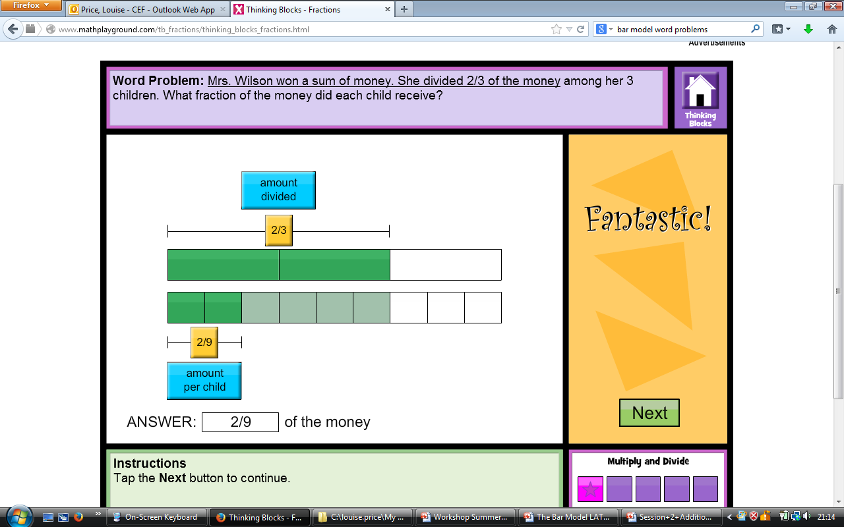

Slide 18
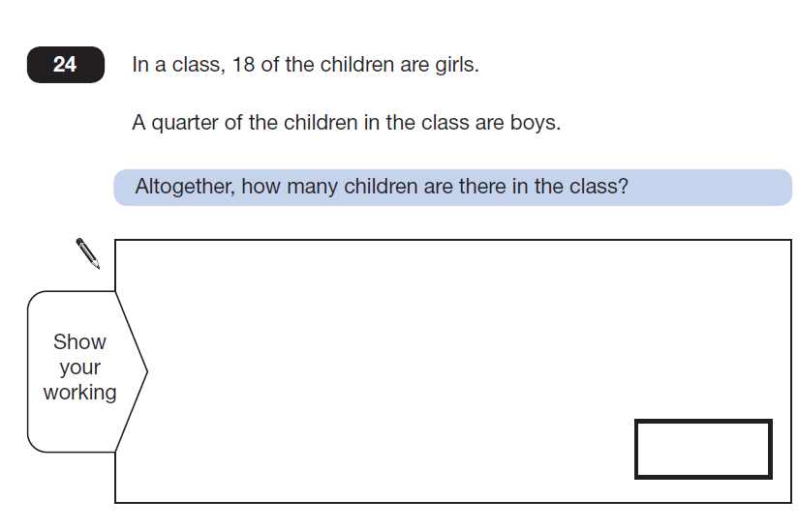

Slide 19
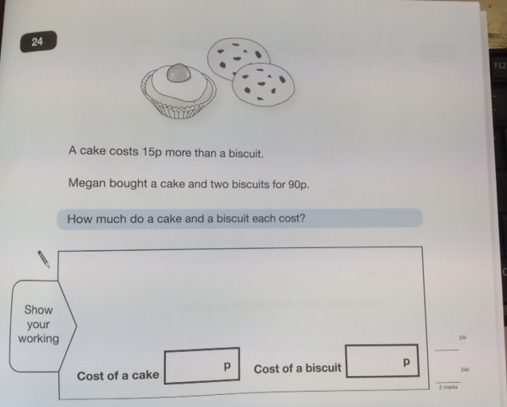

Slide 20


