Slide 1



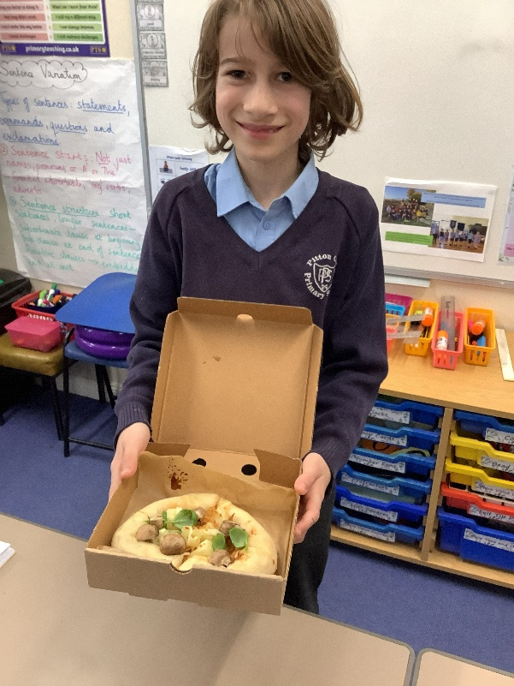
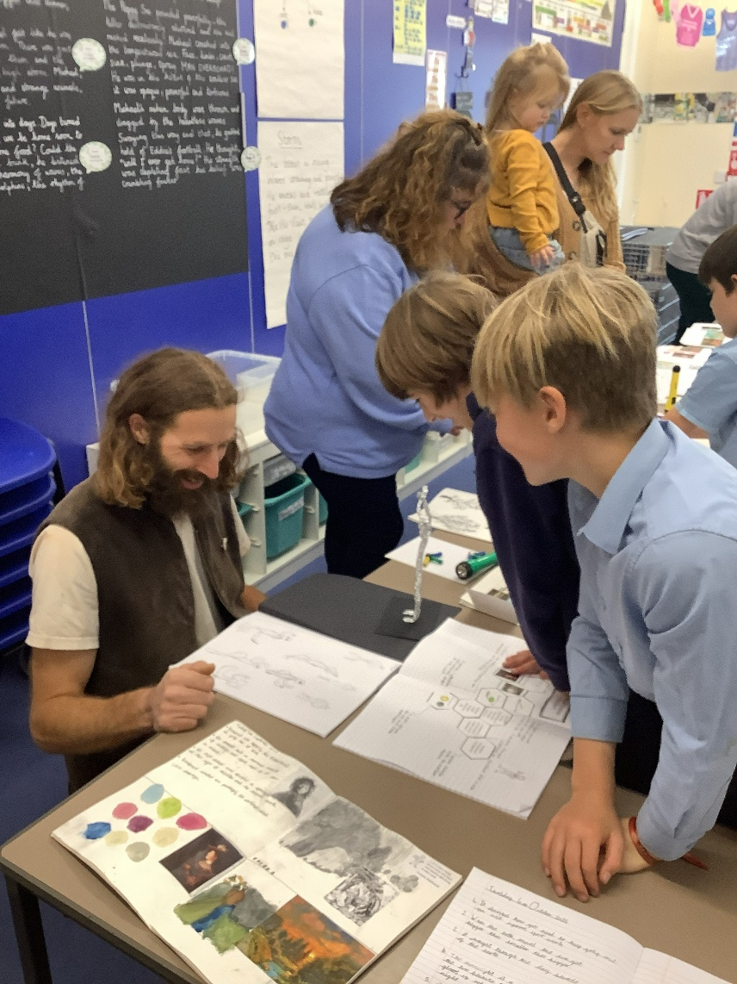
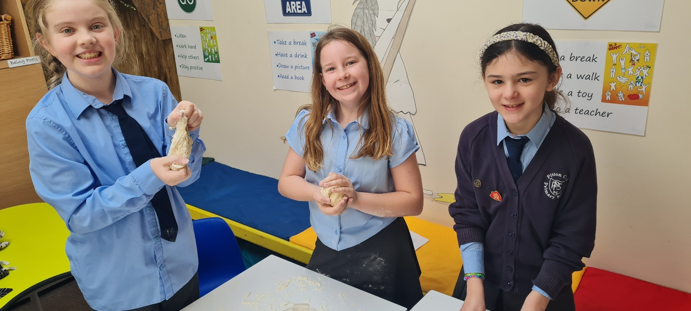
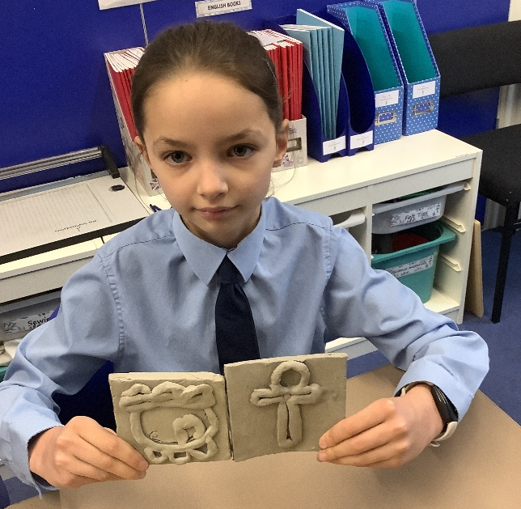
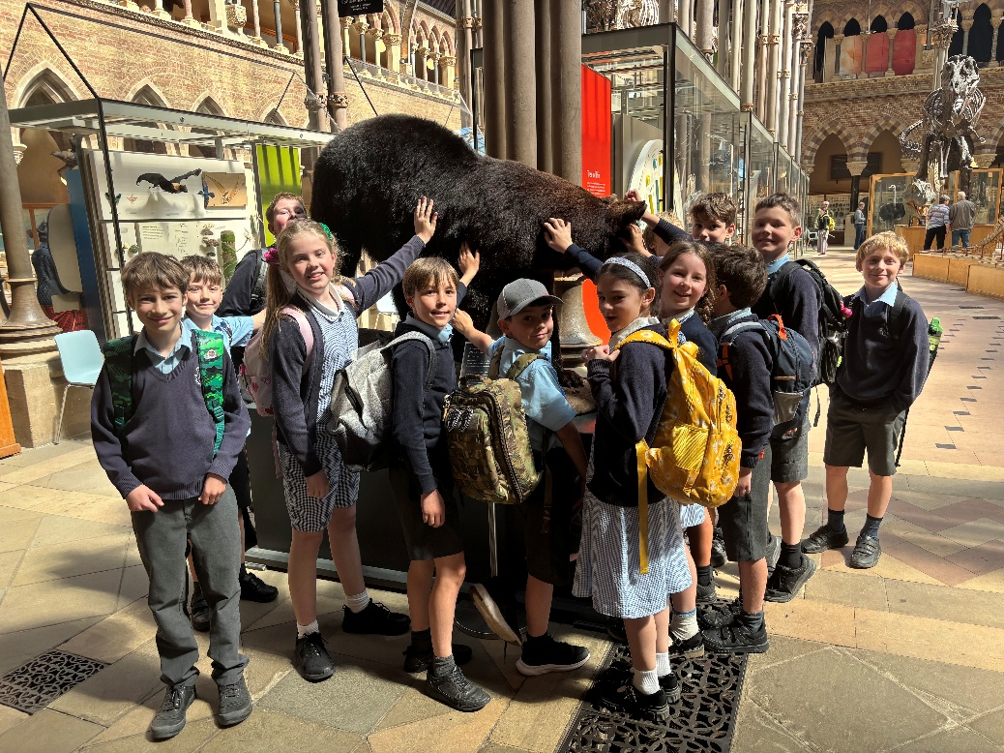
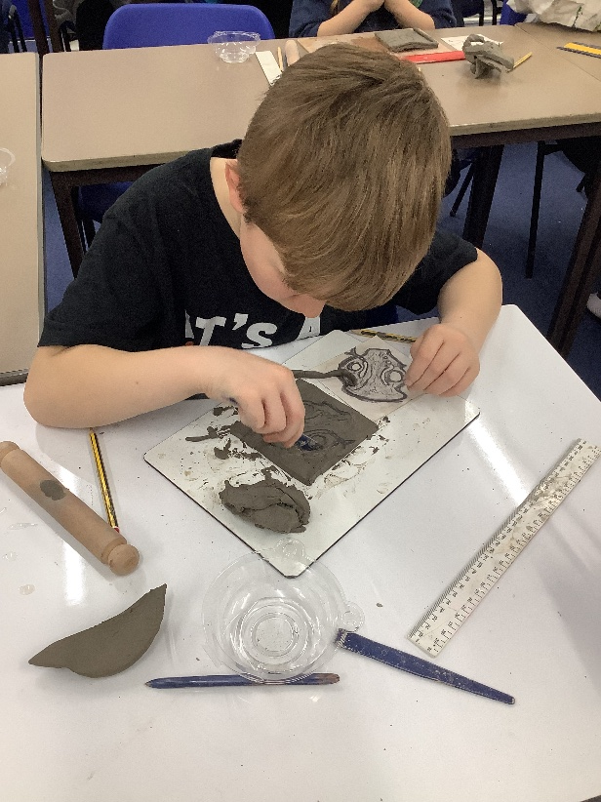
This is
Curious City
at Pitton Primary School
Our Vision: Providing "Life in all its fullness“
The Goal: Moving from children "doing" a subject to "being" the expert
National Curriculum: Fully meets all National Curriculum objectives through an enquiry-based approach
An enquiry-based curriculum for our children at Pitton.

Slide 2
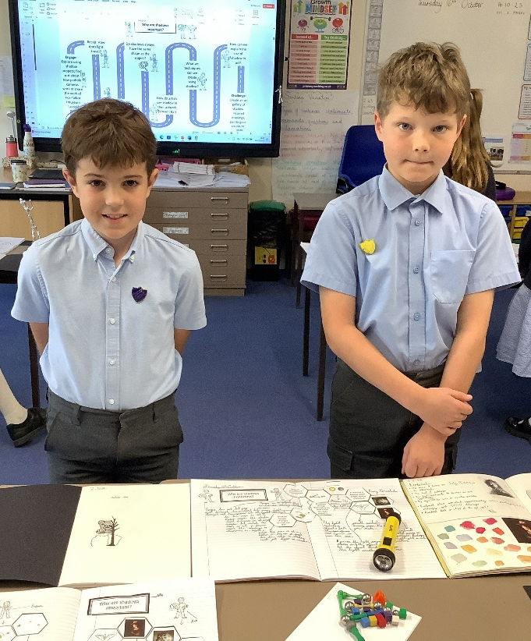
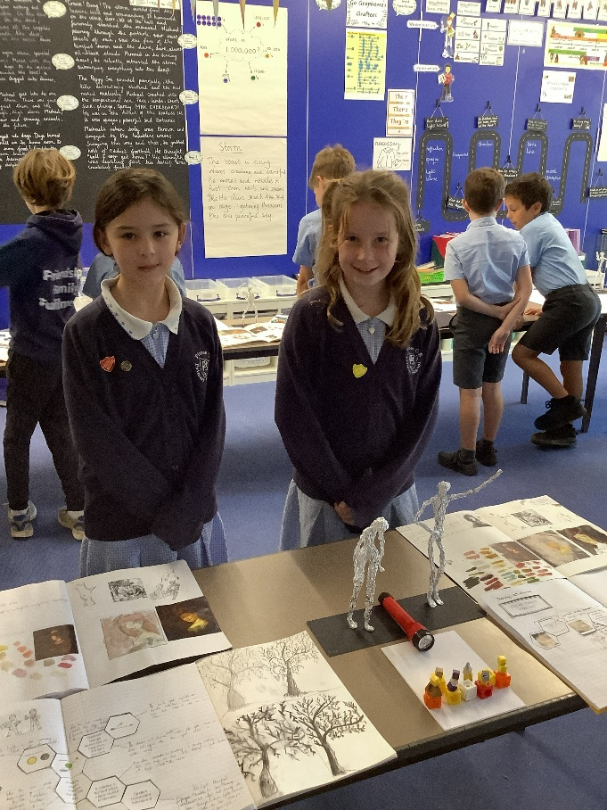
What is Curious City?
How does the Curious City
Curriculum foster a dynamic
learning environment?
  Curious City is our curriculum approach.
  It gives children rich learning experiences based around questions, exploration, and real world relevance.
  It is designed to reflect the values and local context of Pitton Primary School.
The Curious City Curriculum empowers educators to design meaningful inquiry-based experiences tailored to the unique context of Pitton Primary School.
This approach encourages learners to explore and engage with their surroundings, while structured progression helps them develop cognitive skills through a rich educational framework.
Collaboration within a network of like-minded schools and educators further enhances our curriculum, ensuring that it remains innovative and interconnected.
Embracing local context through collaboration transforms education into a curious and engaging journey for learners.

Slide 3
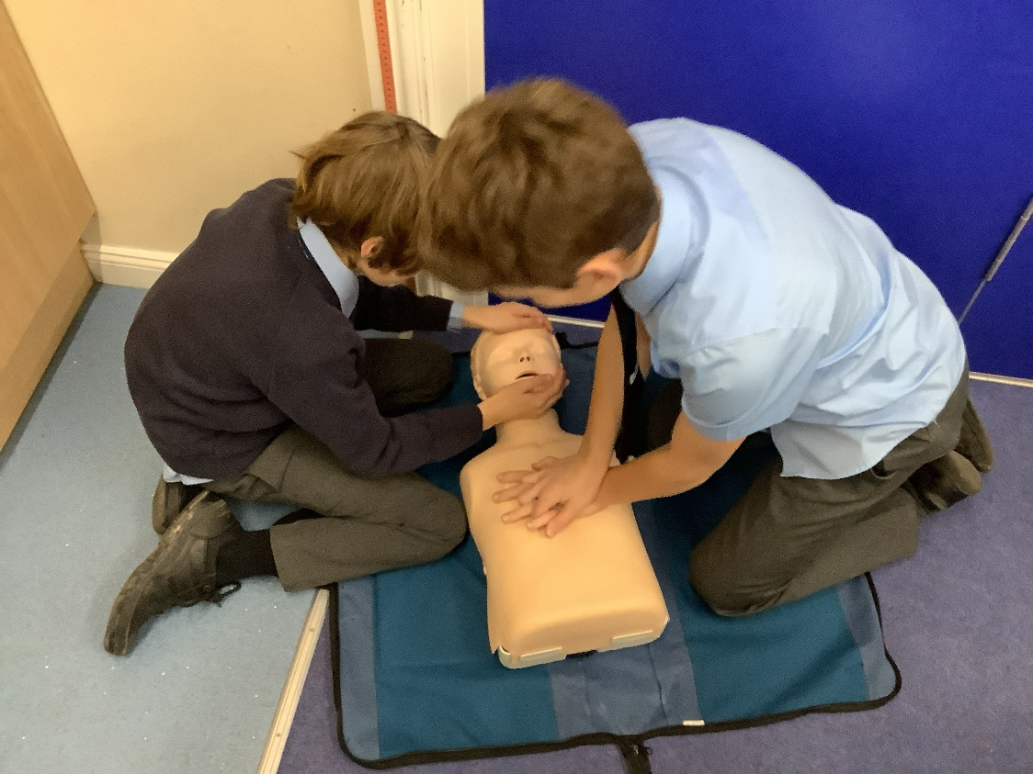
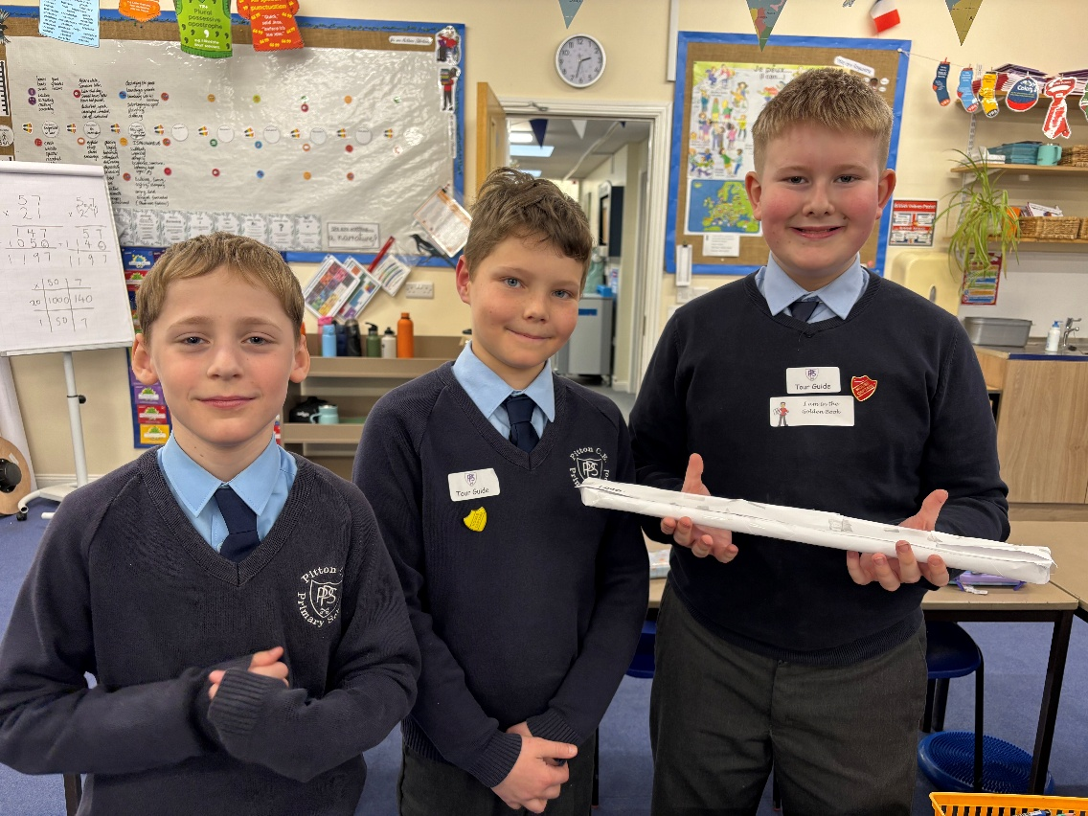
What Is an Enquiry Led Curriculum?
  An enquiry-led curriculum starts with a question.
  Children explore ideas, make links, and investigate the world around them
.
  This helps learning feel purposeful, memorable, and relevant to their lives.
An enquiry-led curriculum promotes a dynamic educational approach where students take the initiative in their learning. By encouraging them to ask questions and engage with their community, such a curriculum not only deepens their understanding but also connects them with the stories and experiences that shape their local environment. This method is flexible and can adapt to contemporary issues, allowing the curriculum to be continually relevant.
Fostering curiosity through enquiry enhances student engagement and connects learning to local contexts.

Slide 4
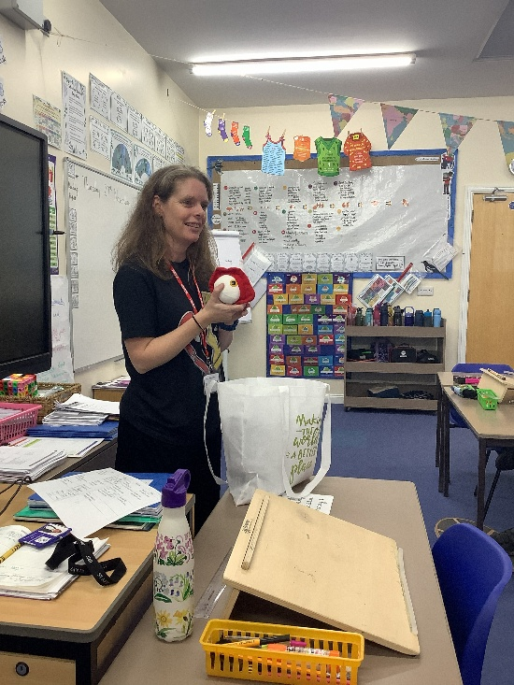
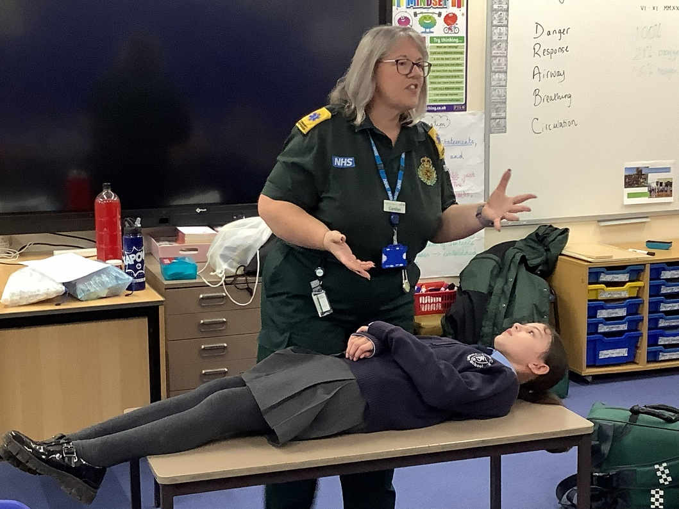
Cognitive Development Alignment
How does enquiry support learning?
  Children learn best when they are curious and involved.
  Enquiry gives them chances to think deeply, talk about ideas, and build knowledge over time.
  It also helps children connect classroom learning with their local community and the wider world.
Inquiry-driven learning encourages students to explore complex questions that spark curiosity and deep thinking, while also developing emotional and linguistic skills.
This approach fosters a structured path for learners to express their understanding through creative outputs, fostering their cognitive development.
Our role is to facilitate a meaningful journey for learners, helping them to interpret and engage with the world around them, rather than simply presenting it to them.

Slide 5
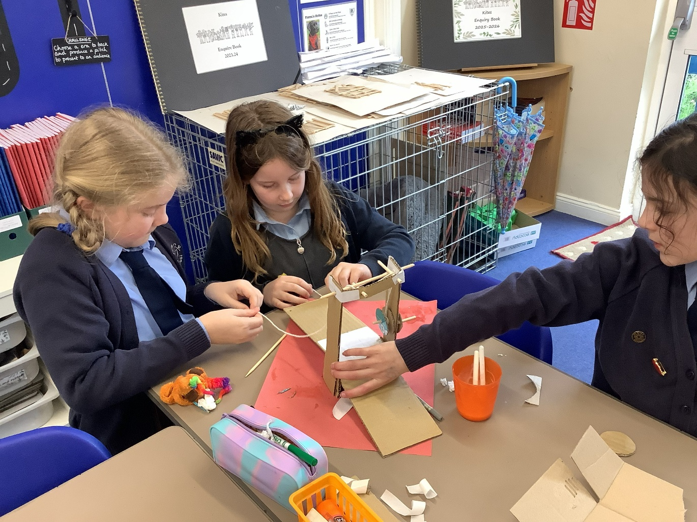
How can we transform traditional learning into immersive experiences?
By viewing a child's education as a continuum of diverse experiences rather than just a series of lessons, we can create a richer learning environment. Engaging with local history, culture, and significant figures allows students to connect their studies with their community, making lessons more relevant. While foundational subjects remain central, integrating these themes helps students relate to the material on a personal level. Some subjects will be taught discretely for depth, while others will naturally interlace with broader inquiries.
We want children to experience learning as something active, connected, and meaningful.
Some subjects are taught in clear, separate lessons, while others are linked through broader themes.
This balance helps children build strong knowledge and see how learning fits together.
A curriculum that values experiential learning fosters deeper connections and understanding, effectively bridging the gap between knowledge and community.
"Life in all its fullness“

Slide 6

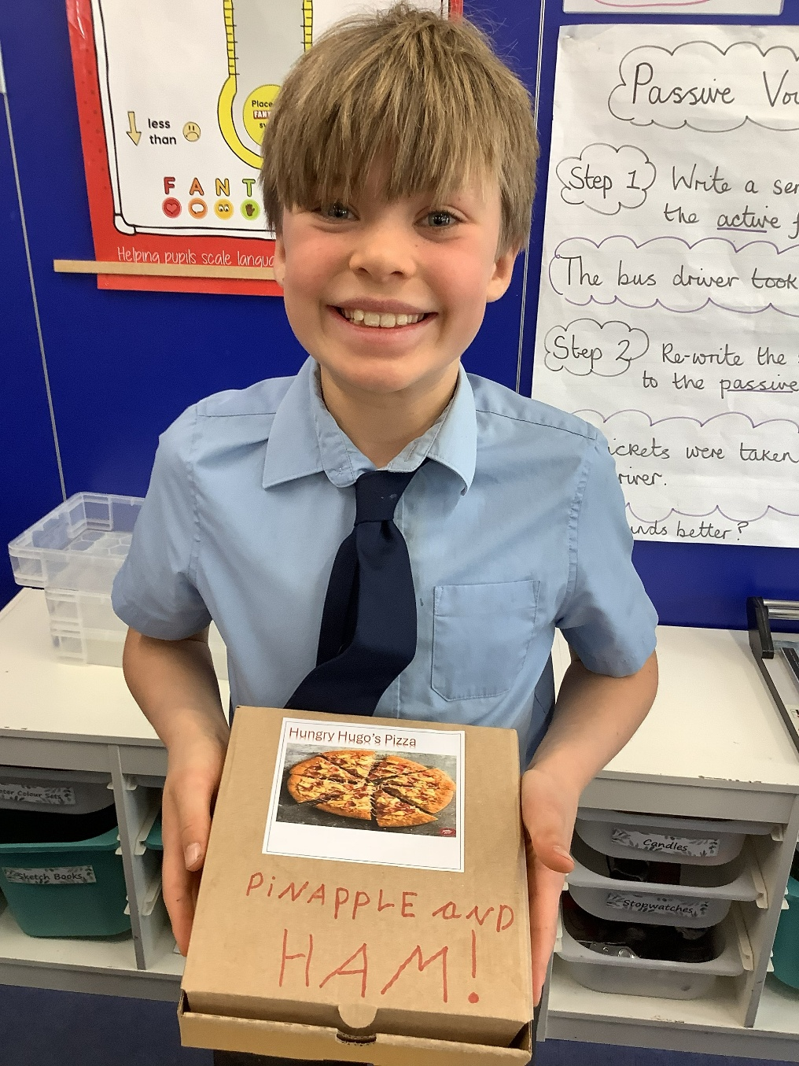
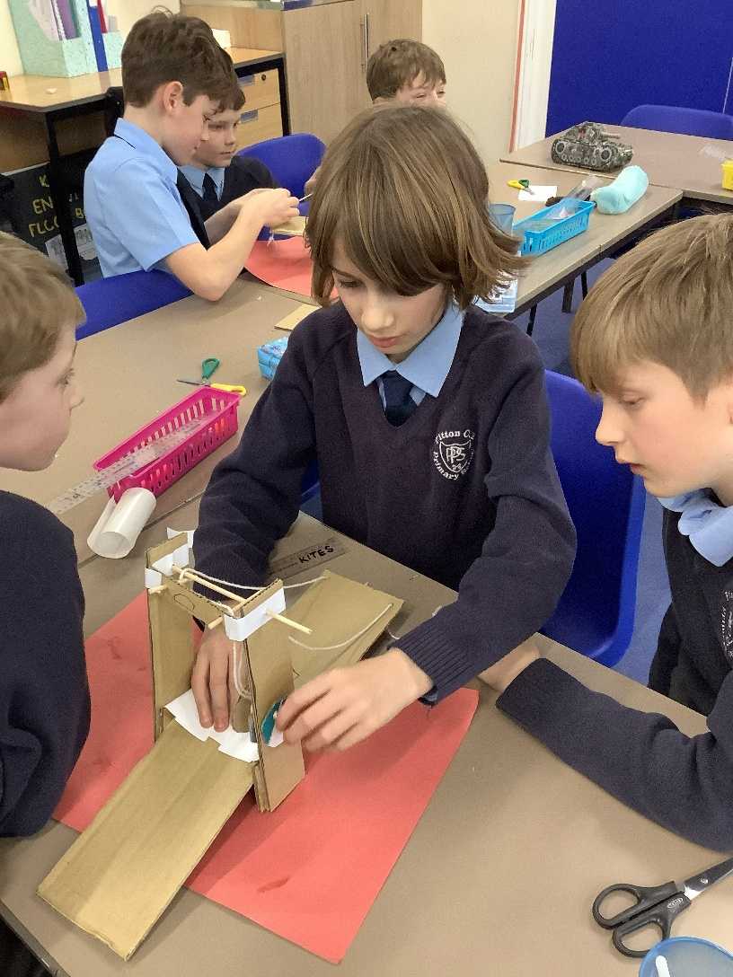
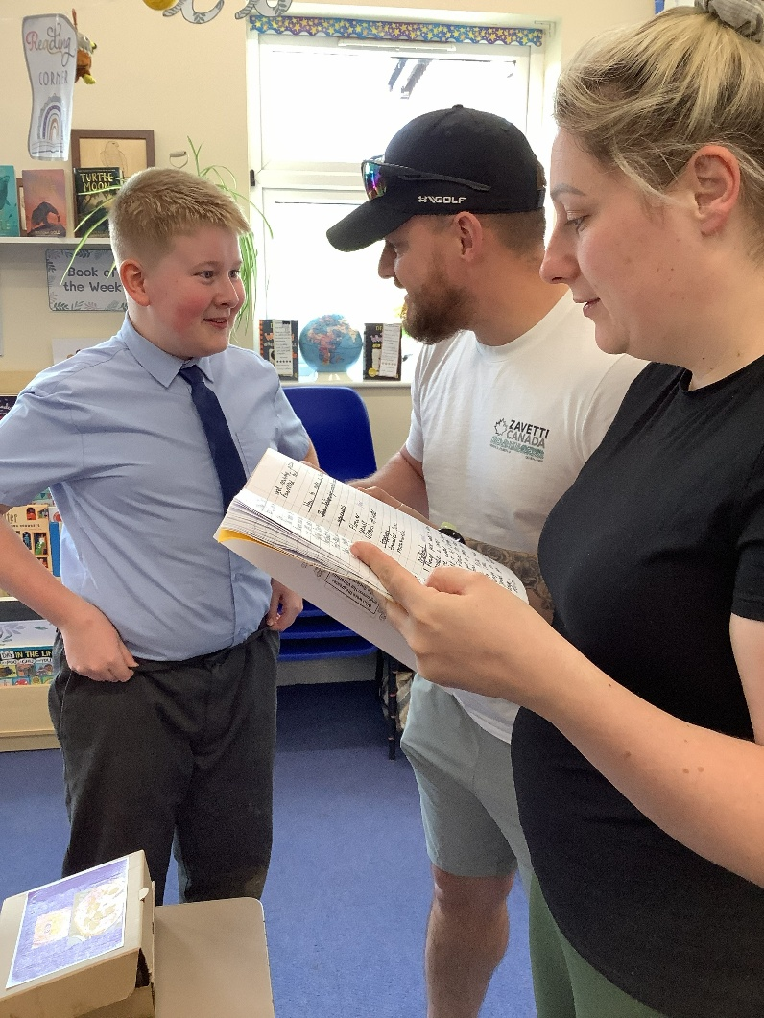
The Enquiry Process
How Learning Unfolds
Question → Immersion → Challenge
local links
The Question: Every enquiry starts with a central question to spark curiosity.
Immersion: Children practice skills and develop knowledge through deep engagement.
The Challenge: Every enquiry ends with a final challenge where children apply their learning to answer the original question.
Local Links: We aim to keep learning fun and relevant with local connections and expert visitors

Slide 7
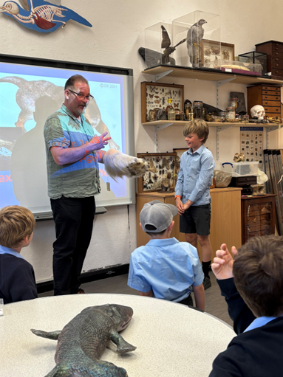
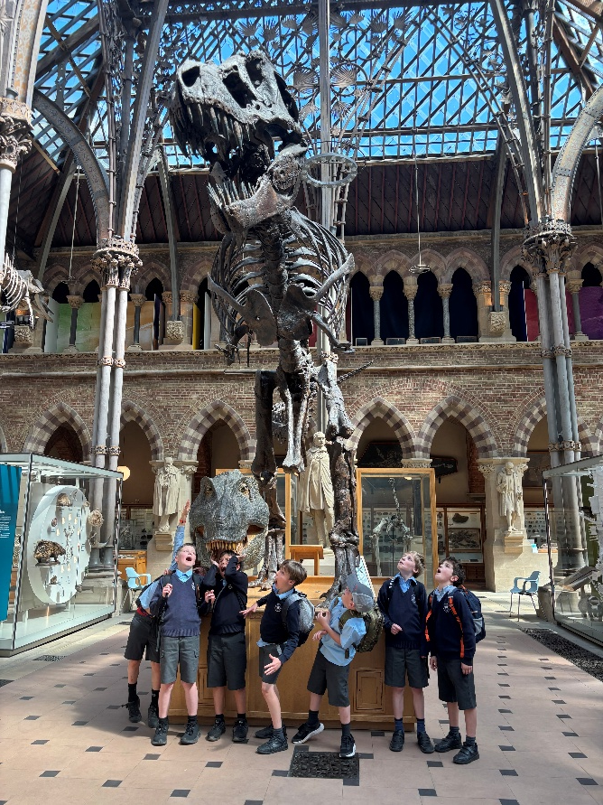
"Being" Not "Doing”
The Power of States of Being
How can States of Being transform our learning experience?
A Shift in Mindset: We move away from "doing" a lesson (like English or Maths) to "being" a specialist (like an Author or Mathematician.
States of Being: These symbols help learners master both the "know of" and the "know how" of a subject.
Cross-Pollination: As children grow, they learn to combine states,
discovering they can be an Author, Scientist, and Philosopher at the same time
States of Being encourage a holistic approach, allowing students to engage deeply with various disciplines. By embodying the roles of Author, Scientist, Historian, Geographer, Engineer or Philosopher, learners appreciate the integration of knowledge across fields and understand real-world applications. This not only enhances retention but fosters critical thinking and creativity by showing the connections between different areas of study.
Instead of only “doing” a subject, children learn to think and work like specialists.
For example, they might think like an author, mathematician, scientist, historian, or engineer.
This helps children understand both the knowledge and the skills behind each subject.
Embracing diverse States of Being helps students become versatile thinkers, preparing them for a multifaceted world.

Slide 8
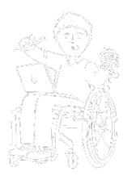
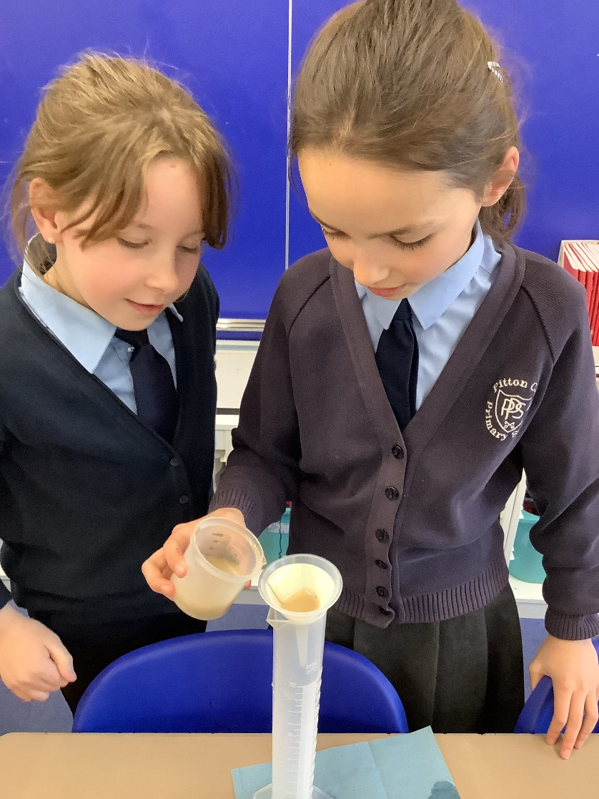
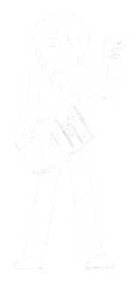
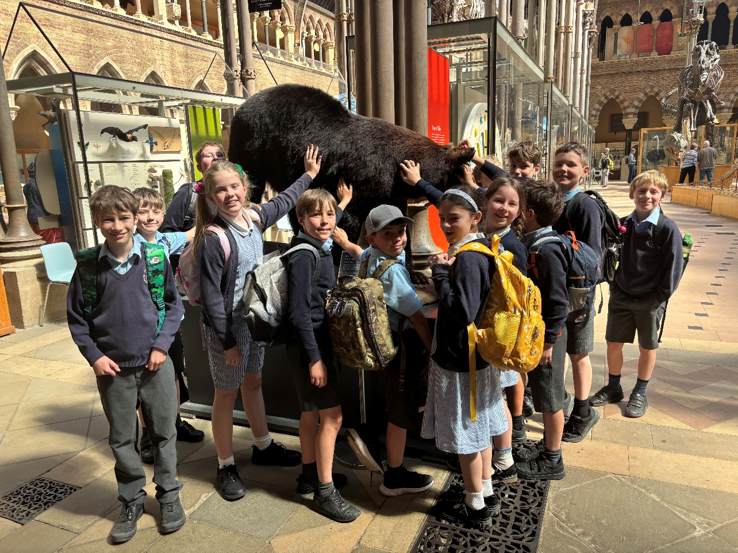
Meet the Specialists: How We Describe Our States of Being
Authors: Read extensively to help write what is in their heads to entertain or inform others
Mathematicians: Use numbers to find solutions for everyday things like cooking or travelling
Scientists: Ask questions and look closely at the world to understand it better
Historians: Use sources and artefacts left behind to understand people and places throughout time
Geographers: Explore, map, and document the world to understand cause and effect
Artists & Musicians: Express complex ideas and emotions through various media and sound
Engineers: Design and improve things to find solutions to problems
Philosophers: Ask "why" questions to make sense of difficult ideas and emotions
Linguists: Understand the world and different cultures through communication
Athletes: Focus on being fit and ambitious while solving problems and staying resilient

Slide 9
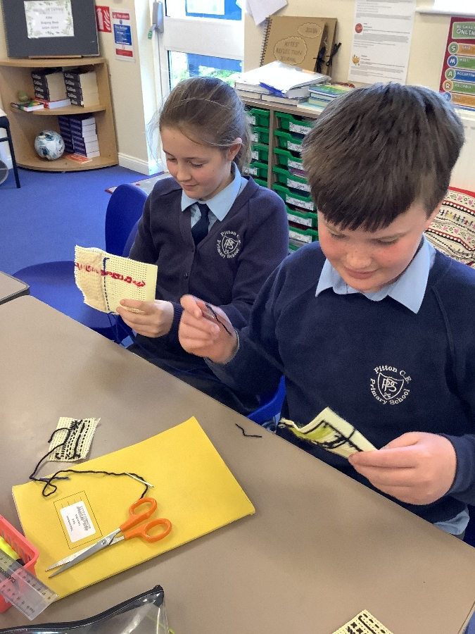
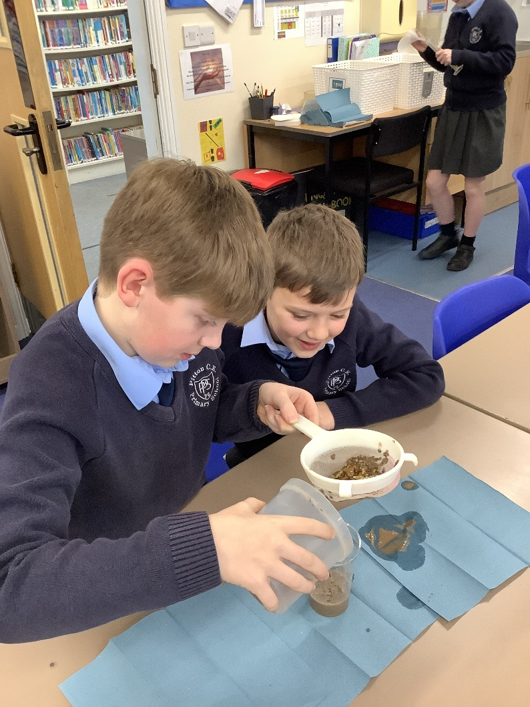
Impact
  Children make stronger connections across subjects.
  Encourages deeper thinking, creativity, and confidence.
  Children see themselves as capable learners who can approach challenges in different ways.
The impact of our enquiry-based learning is evident in the collaborative discussions among pupils, the interactive displays, and the challenges they undertake.
Throughout the academic year, the 'Enquiry Books' serve as a testament to their evolving understanding and creativity.
Our classrooms boast enquiry working walls that vividly illustrate their learning journey. Additionally, 'States of Being' characters are integrated throughout the school, creating a cohesive learning environment that fosters engagement.
This ongoing process strengthens not only their written and verbal communication skills but also reinforces their identity as authors with a clear purpose.
As a result, our students become empowered creators, who approach each task with confidence and curiosity.
The inspectors commended our ambitious curriculum, designed to spark curiosity and ignite a love of learning. Subjects are carefully planned with important knowledge broken down into smaller, manageable steps that build upon each other over time. Teachers regularly check what students remember to ensure they are ready for the next level of learning.
2024 OFSTED Feedback
Enquiry-based learning deepens student engagement and enhances skills by providing meaningful contexts and purposes.

Slide 10
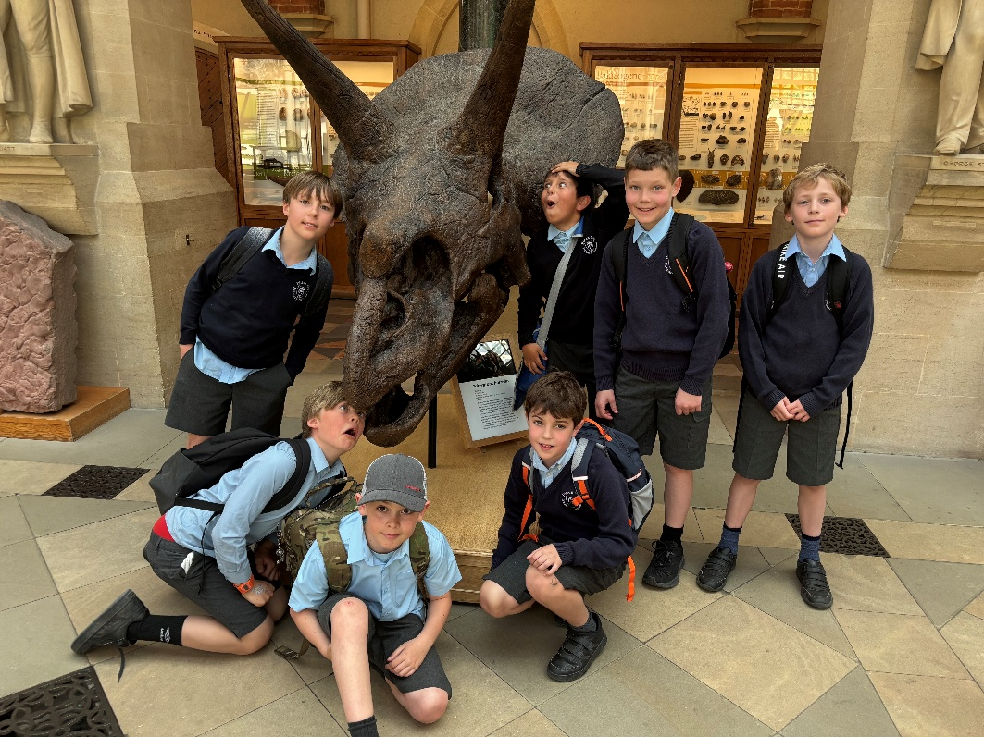
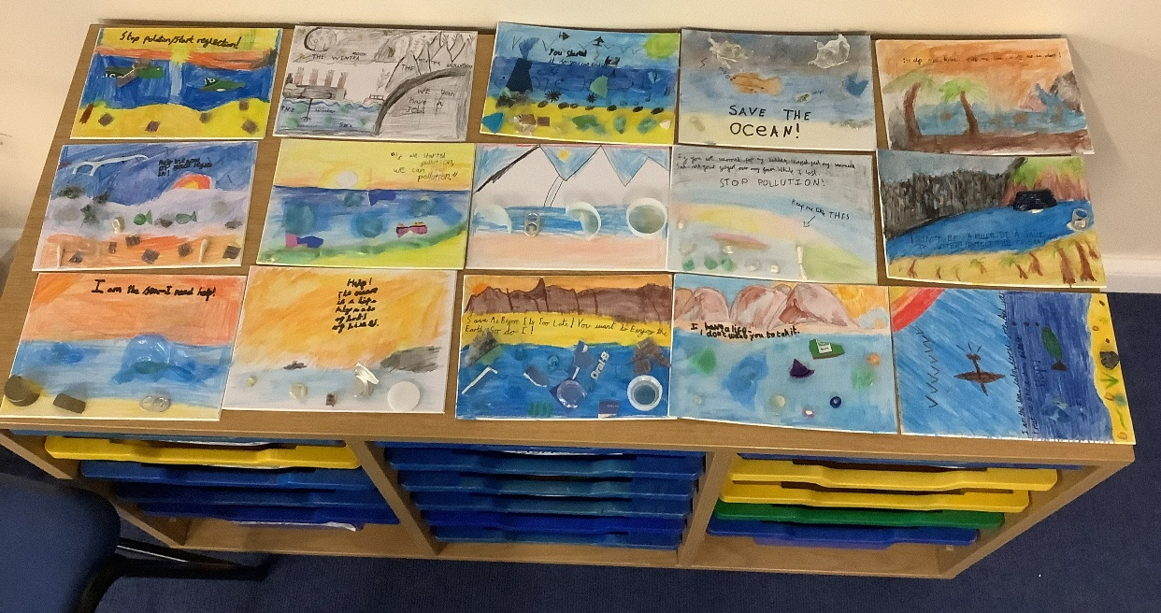

Supporting at Home
Changing the Conversation
The Old Question: "What did you do today?"
Often leads to answers about lunch or playtime
The New Question:
"What have you been today?“
Prompting Reflection
"How were you an Author?" or "What did you learn as a Scientist?“
Ownership: This language places the ownership of learning onto the child.

Slide 11


Reception / Year 1 / Year 2
Curriculum Overview: Cycle B
Term | Enquiry Question | Key ‘States of Being’
Terms 1 & 2 | What are we? How do we live a healthy life? What could my classroom be made of? | Scientist, Artist Engineer, Artist, Scientist Scientist, Engineer, Historian, Artist
Terms 3 & 4 | What is significant about Polar Exploration? What is home? | Geographer, Engineer, Historian Scientist, Geographer, Artist
Terms 5 & 6 | How are schools the same? How do plants grow near me? What did Brunel do for Great Britain? | Geographer, Artist Scientist, Geographer, Artist Historian, Engineer, Scientist

Slide 12

Year 3 / Year 4
Curriculum Overview: Cycle B
Term | Enquiry Question | Key ‘States of Being’
Terms 1 & 2 | Why do we live here? What is creativity? | Geographer, Historian, Artist Artist, Musician, Engineer
Terms 3 & 4 | What is the difference between noise and sound? Why don't we all eat the same food? Who has stood here before us? | Scientist, Engineer, Musician Scientist, Engineer Historian, Artist
Terms 5 & 6 | Where does our water come from? What should you flush down the loo? How can we switch off? | Scientist, Geographer, Artist Scientist, Geographer, Engineer Scientist, Geographer, Engineer

Slide 13
Year 5 / Year 6
Curriculum Overview: Cycle B
Term | Enquiry Question | Key ‘States of Being’
Terms 1 & 2 | Why are shadows important? How are lives saved? | Scientist, Artist Scientist, Historian, Artist
Terms 3 & 4 | Who were the greater Engineers - The Ancient Britons or the Victorians? Where does our food really come from? | Engineer, Historian, Artist Geographer, Engineer
Terms 5 & 6 | Linnaeus and Darwin: Are they connected? How do we all live together? How big is your footprint? | Scientist, Historian Historian, Philosopher Scientist, Geographer, Artist

